Slide 1
Sidewalk Image Classification and Segmentation

Slide 2
Outline:
Problem
Data Acquisition
Modelling: Classification
Modelling: Segmentation
Future Directions

Slide 3
Problem:
Sidewalks are an important mobility feature of neighborhoods
Potential renters and homebuyers would like to know about sidewalk coverage in neighborhood
City governments records of sidewalk extent for maintenance

Slide 4
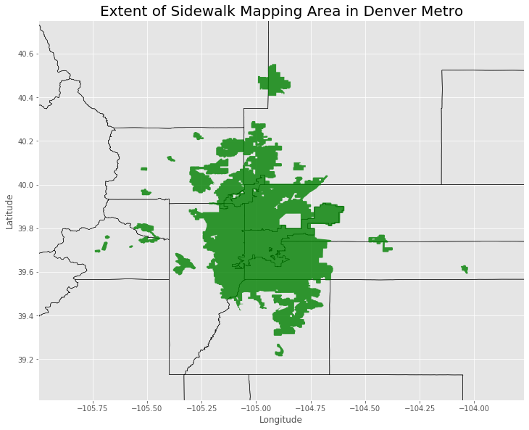
Data Scope:

Slide 5
Image Downloading Class
Class to download images with Latitude, Longitude, Heading, and Label
Generate Random point within survey region
Query streetview API for nearest image point
Confirm point is within street polygon
Find nearest street polygon edge & convert to direction
Test if sidewalk exists in direction within set distance
Save parameters and download image

Slide 6
Example Images with Validation

Slide 7
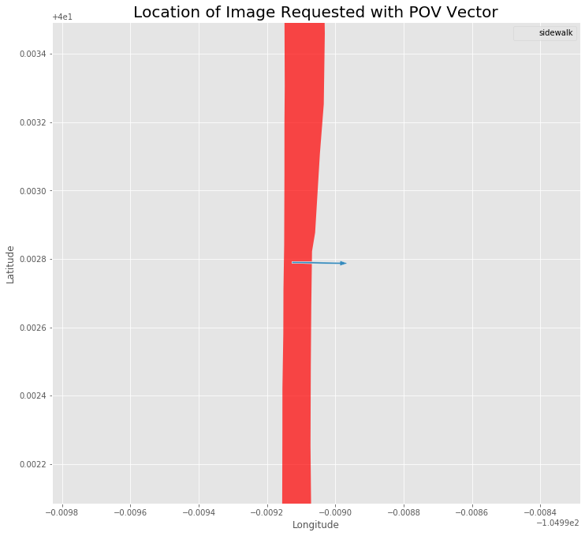
[268.79833469817083, [40.00278986277844, -104.9991271379266], 'no_sidewalk’]

Slide 8
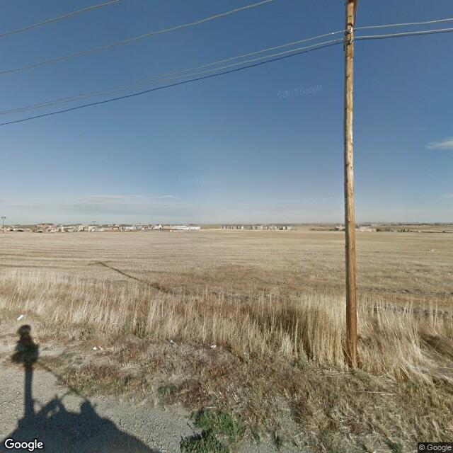
[268.79833469817083, [40.00278986277844, -104.9991271379266], 'no_sidewalk’]

Slide 9
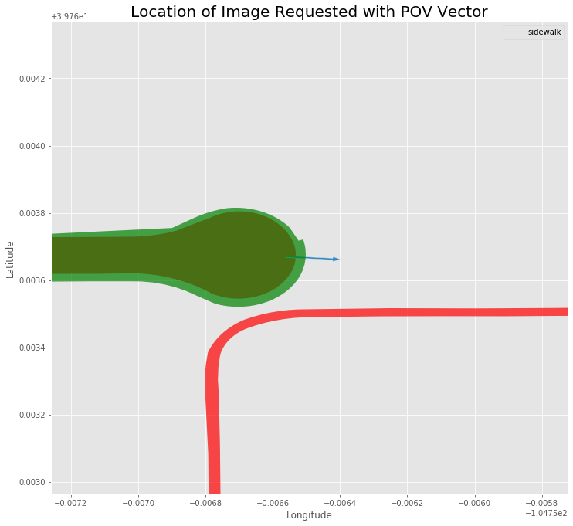
[93.8101431467257, [39.7636699, -104.7565609], 'sidewalk']

Slide 10
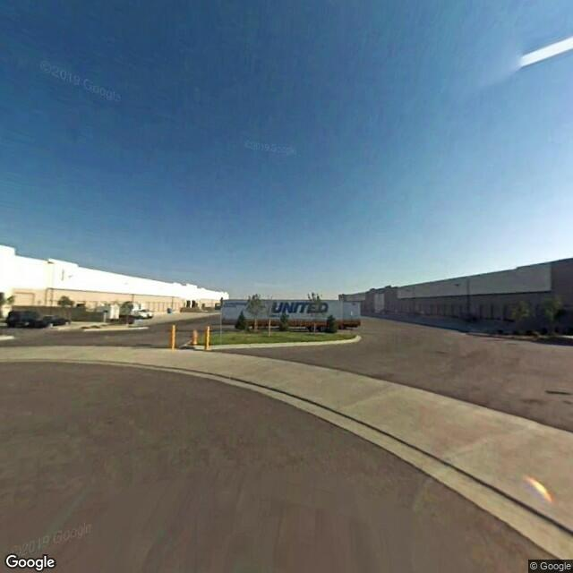
[93.8101431467257, [39.7636699, -104.7565609], 'sidewalk']

Slide 11
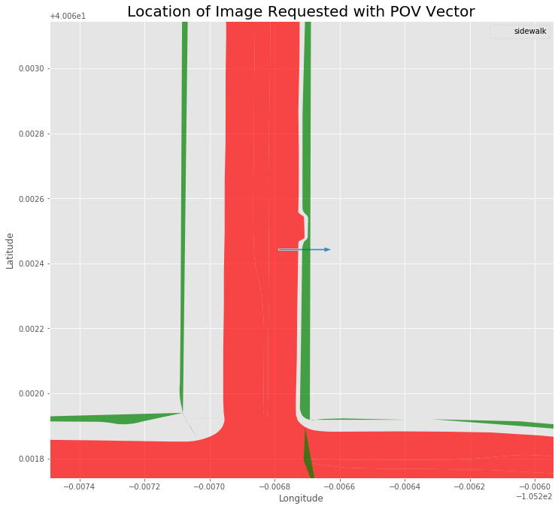
[269.9812922349449, [40.06244274355016, -105.2067883010862], 'sidewalk']

Slide 12
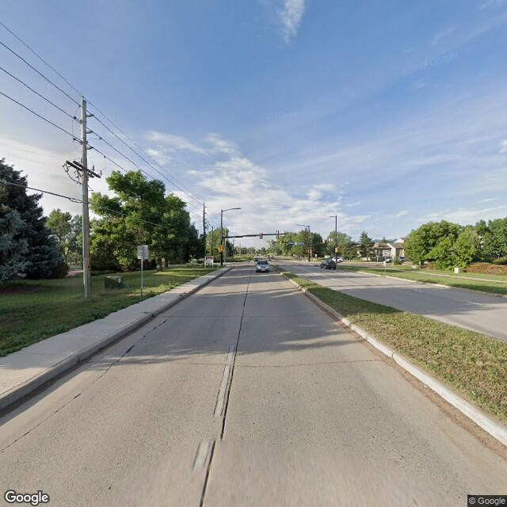
[269.9812922349449, [40.06244274355016, -105.2067883010862], 'sidewalk']

Slide 13
Data Results
18,000 Images
77% had sidewalks
Around 15% of the images acquired had incorrect labels. This could be for multiple reasons:
new construction in last several years
partial sidewalk
ambiguous ‘sidewalks’
some panoramas from google are rotated up to 90 degrees so may include part of the opposite road

Slide 14
Data Results:
The images covered most of the region
Non-sidewalk images generally were from outlying areas
Non-sidewalk images were less distributed

Slide 15
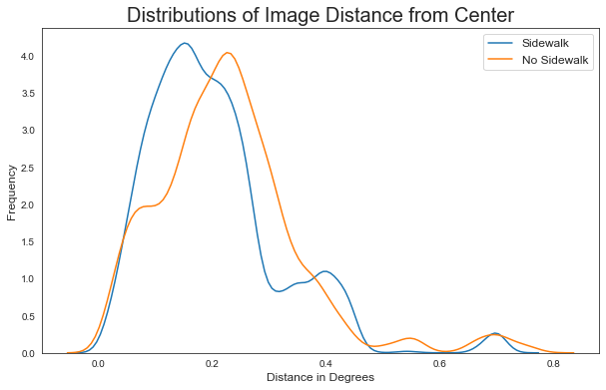
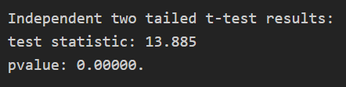
Data Results:

Slide 16
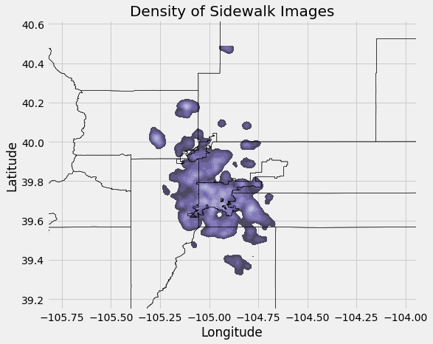
Data Results:

Slide 17
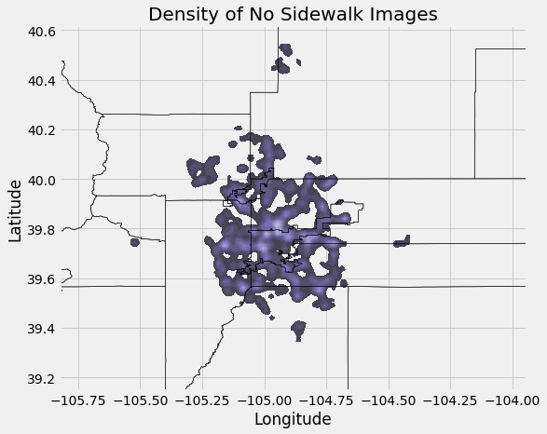
Data Results:

Slide 18
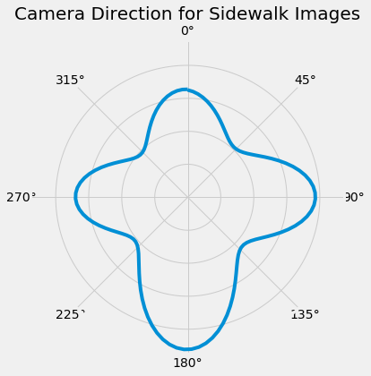
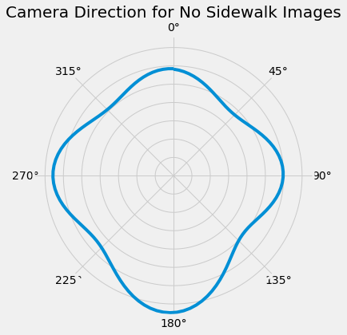
Data Results:

Slide 19
Modelling: Classification
Use tf.keras to build models:
Model with several convolutional layers
Pretrained models:
Mobilenetv3
Xception

Slide 20
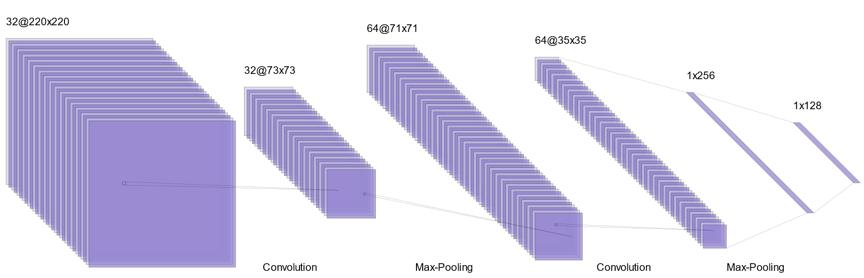
Modelling: Classification
Convolutional Model
Architecture:
Not including Dropout, BatchNormalization
RELU Activation (Sigmoid Final layer)
HE Uniform Kernel Initialization for Convolution layers
ADAM optimizer
Loss=Binary Cross-entropy
Metric for choice of saved model: Matthew Coefficient

Slide 21
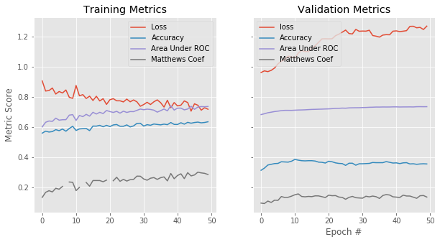
Modelling: Classification
Convolutional Model:
LR=0.000_1

Slide 22
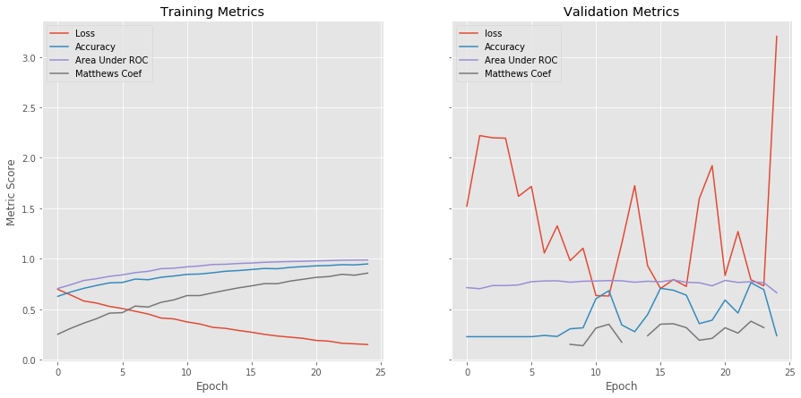
Modelling: Classification
Convolutional Model:
Learning Rate = .005

Slide 23
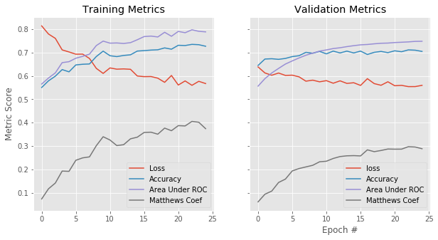
Modelling: Classification
Mobilenetv3

Slide 24
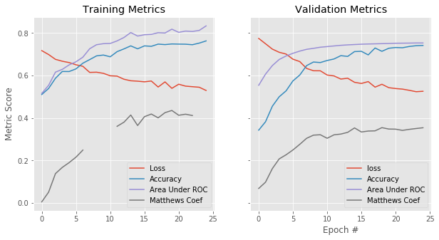
Modelling: Classification
Xception

Slide 25
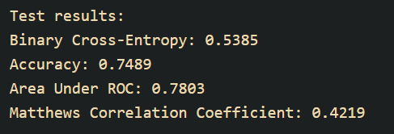
Modelling: Classification
Xception

Slide 26
Modelling: Image Segmentation
U-net Model
Encoders and Decoders, with skip connection

Slide 27
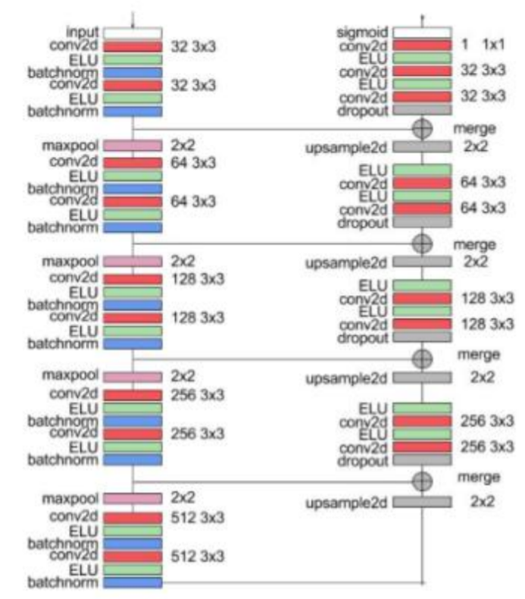
Architecture Design:
Ref: http://cs230.stanford.edu/files_winter_2018/projects/6937642.pdf

Slide 28
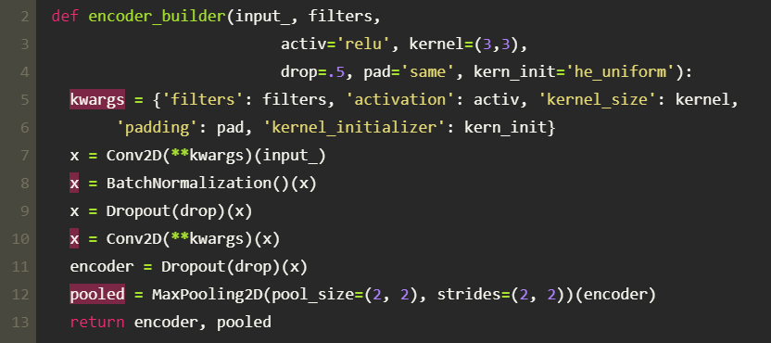
Modelling: : Image Segmentation
Encoder Block:

Slide 29
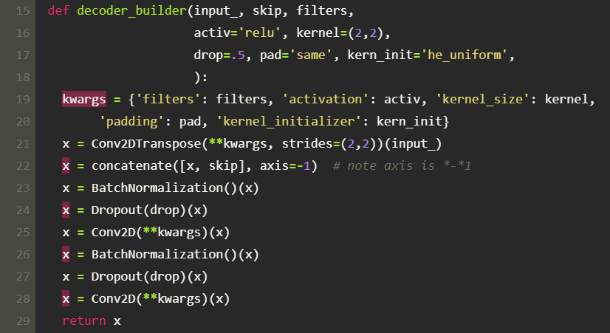
Modelling: Image Segmentation
Decoder Block:

Slide 30
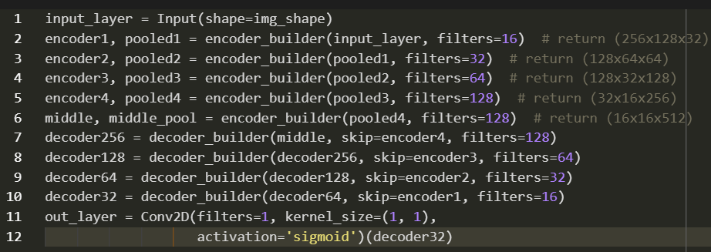
Modelling: Image Segmentation
Overall Structure:

Slide 31
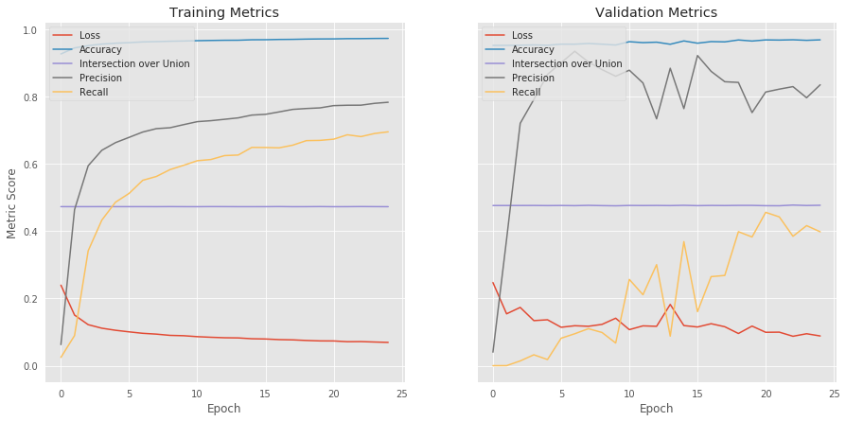
Modelling:
Learning Rate: .0001

Slide 32
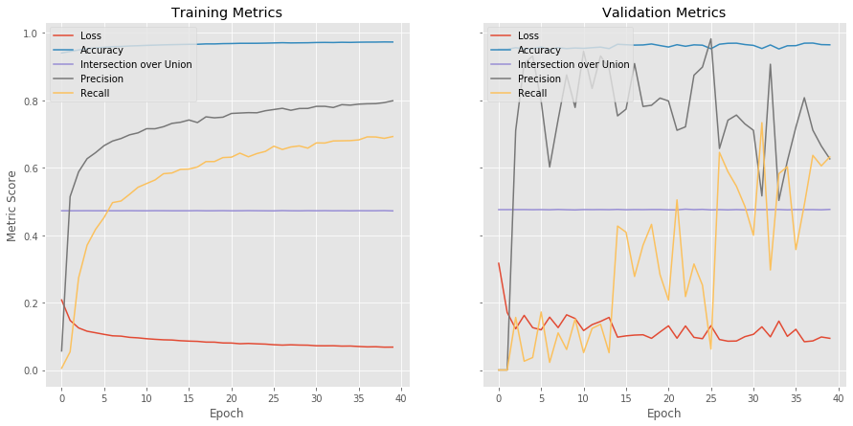
Modelling:
Learning Rate: .007

Slide 33
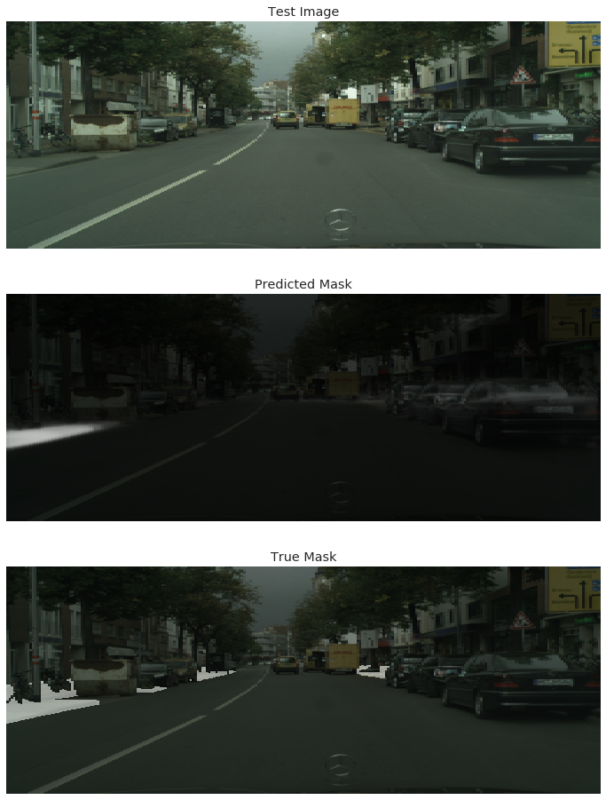
Modelling: Image Segmentation

Slide 34
Modelling: Image Segmentation

Slide 35
Modelling: Image Segmentation

Slide 36
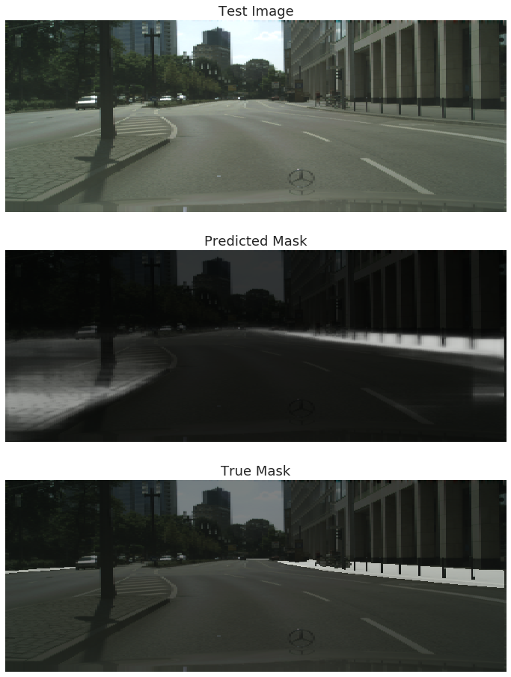
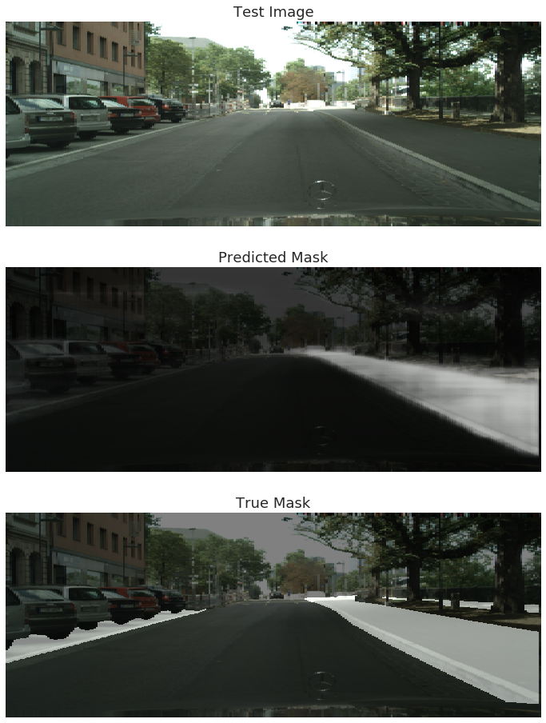

Slide 37
Modelling: Direct Transfer Learning
Use of trained U-net Model on Denver Street Images:

Slide 38
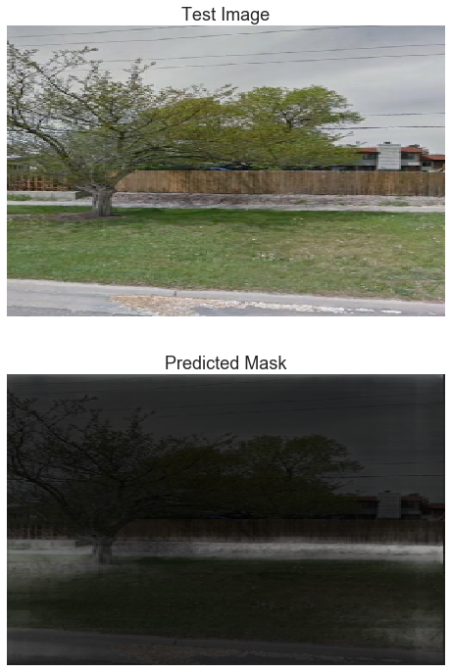

Slide 39
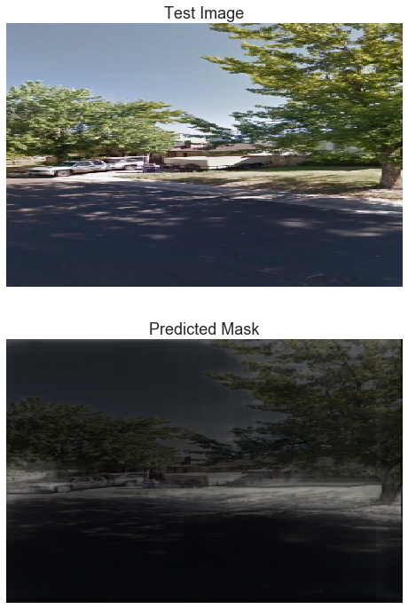

Slide 40
Modelling: Direct Transfer Learning
Images without Sidewalks:

Slide 41
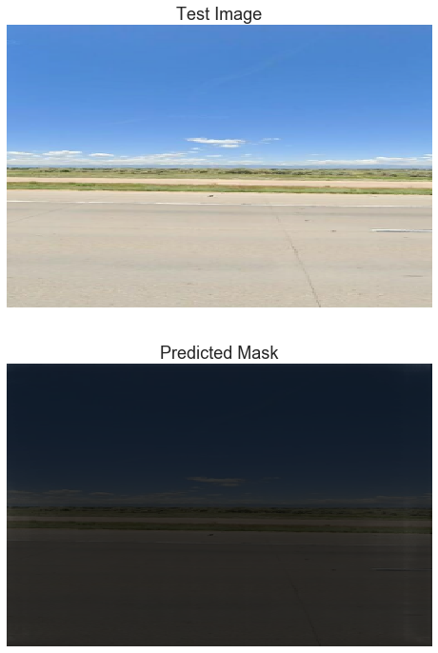

Slide 42
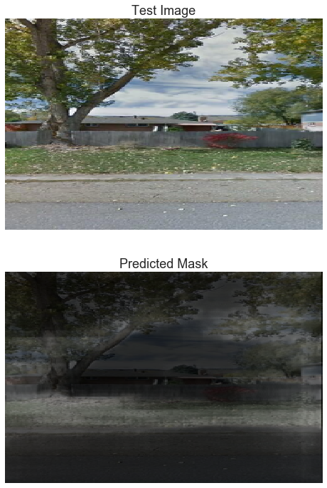

Slide 43
Known Problems
Misclassified images
Mean Intersection over Union measure stuck at 47%
Find better data augmentation parameters that improve validation scores
Segmentation output as probability, not binary

Slide 44
Future Directions
Additional tuning of hyperparameters
Unfreezing Xception model for additional training
Additional Data
Binary segmentation vs probabilistic
Pretrained backbone for Unet Model
Segmentation labeling the Denver dataset for additional training
Using segmentation model to classify
Reducing code down to CLI script

Slide 45
Conclusions
Image data obtainable from geojson data & Google API
Several models work for identification
Pre-trained is best
Image segmentation:
Unet Model works well
Can transfer

Slide 46
Questions?

